Slide 1
Lecture 18alt
I_{DDQ} Testing
(Alternative for Lectures 21 and 22)
Definition
Faults detected by I_{DDQ} tests
Weak fault
Leakage fault
Sematech and other studies
ΔI_{DDQ} testing
Built-in current (BIC) sensor
Summary

Slide 2
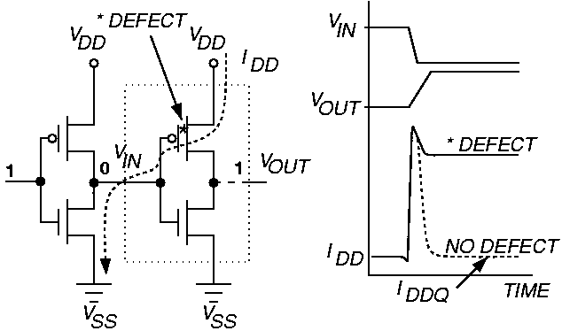
Basic Principle of I_{DDQ} Testing
  Measure I_{DDQ} current through V_{ss} bus

Slide 3
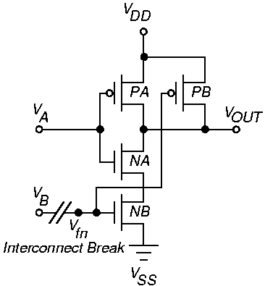
NAND Open Circuit Defect – Floating gate

Slide 4
Floating Gate Defects
Small break in logic gate inputs (100 – 200 Angstroms) lets wires couple by electron tunneling
  Delay fault and I_{DDQ} fault
Large open results in stuck-at fault – not detectable by I_{DDQ} test
  If V_{tn} < V_{fn} < V_{DD} – | V_{tp} | then detectable by I_{DDQ} test

Slide 5
Delay Faults
Many random CMOS defects cause a timing delay fault, not catastrophic failure
Some delay faults detected by I_{DDQ} test – late switching of logic gates keeps I_{DDQ} elevated
Delay faults not detected by I_{DDQ} test
  Resistive via fault in interconnect
  Increased transistor threshold voltage fault

Slide 6
Weak Faults
nFET passes logic 1 as 5 V – V_{tn}
pFET passes logic 0 as 0 V + |V_{tp}|
Weak fault – one device in C-switch does not turn on
  Causes logic value degradation in C-switch

Slide 7
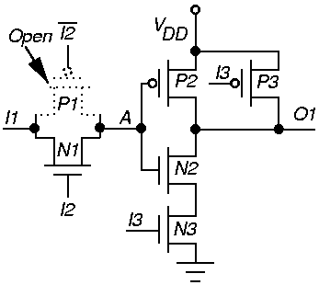
Weak Fault Detection
Fault not detected unless I3 = 1

Slide 8
Leakage Fault
Leakage between bulk (B), gate (G), source (S) and drain (D)
Leakage fault table for an MOS component:
  k = number of component I/O pins
  n = number of component transistors
  m = 2^{k} (number of I/O combinations)
  m x n matrix M represents the table
  Each I/O combination is a matrix row
  Entry m_{i j} = octal leakage fault information:
    Flags f_{BG} f_{BD} f_{BS} f_{SD} f_{GD} f_{GS}
    Sub-entry m_{i j} = 1 if leakage fault detected

Slide 9
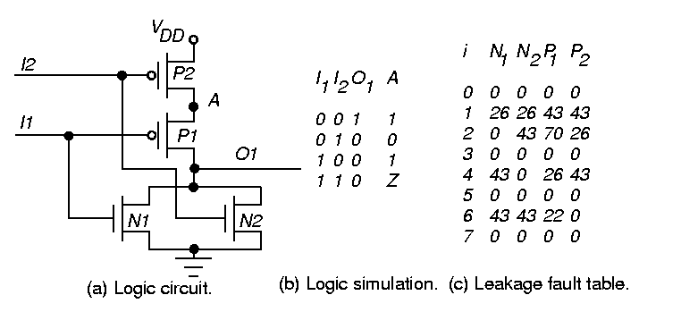
Leakage Fault Table

Slide 10
I_{DDQ} Vector Selection
Characterize each logic component using switch-level simulation – relate input/output logic values & internal states to:
  leakage fault detection
  weak fault sensitization and propagation
Store information in leakage and weak fault tables
Generate complete stuck-at fault tests
Logic simulate stuck-at fault tests – use tables to find faults detected by each vector to select vectors for current measurement

Slide 11
HP and Sandia Lab Data
HP – static CMOS standard cell, 8577 gates, 436 FF
Sandia Laboratories – 5000 static RAM tests
Reject ratio (%) for various tests:
Reject ratio (%)
Company
HP
Sandia
I_{DDQ}
Without I_{DDQ}
With I_{DDQ}
Without I_{DDQ}
With I_{DDQ}
No
Test
16.46
0.80
Only
Funct.
6.36
0.09
Only
Scan
6.04
0.11
Both
5.80
0.00
Functional Tests
5.562
0

Slide 12
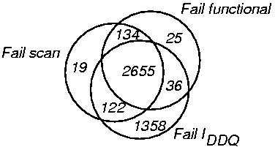
Failure Distribution in Hewlett-Packard Chip

Slide 13
Sematech Study
IBM Graphics controller chip – CMOS ASIC, 166,000 standard cells
0.8μ static CMOS, 0.45μ lines (L_{eff}), 40 to 50 MHz clock, 3 metal layers, 2 clocks
Full boundary scan on chip
Tests:
  Scan flush – 25 ns latch-to-latch delay test
  99.7 % scan-based stuck-at faults (slow 400 ns rate)
  52 % SAF coverage functional tests (manually created)
  90 % transition delay fault coverage tests
  96 % pseudo-stuck-at fault coverage I_{DDQ} tests

Slide 14
Sematech Results
Test process: Wafer Test → Package Test → Burn-In & Retest → Characterize & Failure Analysis
Data for devices failing some, but not all, tests.
IDDQ (5 mA limit)
pass
14
6
52
pass
pass
6
0
1
36
fail
fail
1463
34
13
1251
pass
fail
7
1
8
fail
pass
fail
pass
fail
pass
pass
fail
fail
Scan-based Stuck-at
Scan-based delay
Functional

Slide 15
Sematech Conclusions
Hard to find point differentiating good and bad devices for I_{DDQ} & delay tests
High # passed functional test, failed all others
High # passed all tests, failed I_{DDQ} > 5 mA
Large # passed stuck-at and functional tests
  Failed delay & IDDQ tests
Large # failed stuck-at & delay tests
  Passed I_{DDQ} & functional tests
Delay test caught failures in chips at higher temperature burn-in – chips passed at lower temperature

Slide 16
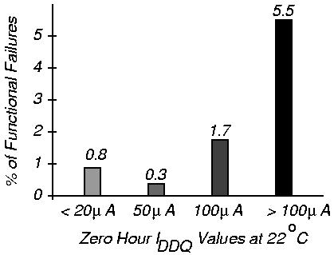
% Functional Failures After 100 Hours Life Test
Work of McEuen at Ford Microelectronics

Slide 17
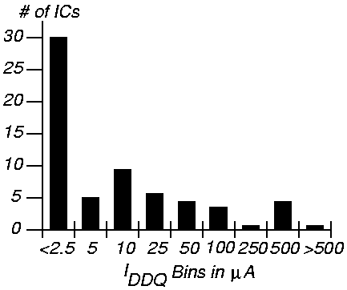
Current Limit Setting
Should try to get it < 1 mA
Histogram for 32 bit microprocessor

Slide 18
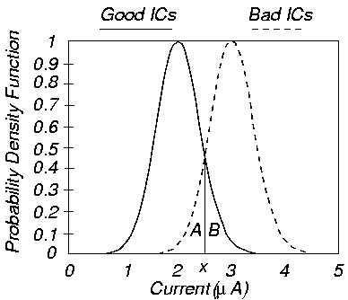
Difference in Histograms
A – test escapes, B – yield loss

Slide 19
Delta I_{DDQ} Testing (Thibeault)
Use derivative of I_{DDQ} at test vector i as current signature
ΔI_{DDQ} (i) = I_{DDQ} (i) – I_{DDQ} (i – 1)
Leads to a narrower histogram
Eliminates variation between chips and between wafers
Select decision threshold Δ_{def} to minimize probability of false test decisions

Slide 20
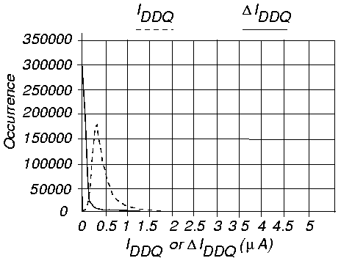
|I_{DDQ}| and |ΔI_{DDQ}|

Slide 21
Setting Threshold
 | I_{DDQ} | ΔI_{DDQ}
Mean (good chips) | 0.696 μA | -2×10⁻⁴ μA
Mean (bad chips) | 1.096 μA | 0.4 μA
Variance | 0.039 (μA)² | 0.004 (μA)²
Δ_{def} | Error Prob. | Error Prob.
0.3 | 0.059 | 7.3×10⁻⁴
0.4 | 0.032 | 4.4×10⁻⁵
0.5 | 0.017 | 1.7×10⁻⁶

Slide 22
I_{DDQ} Built-in Current Testing – Maly and Nigh
Build current sensor into ground bus of device-under-test
Voltage drop device and comparator
  Compares virtual ground V_{GND} with V_{ref} at end of each clock – V_{GND} > V_{ref} only in bad circuits
  Activates circuit breaker when bad device found

Slide 23
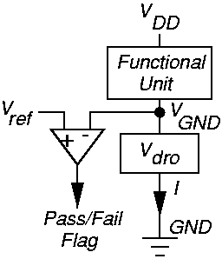
Conceptual BIC Sensor

Slide 24
Summary
I_{DDQ} test is used as a reliability screen
  Can be a possible replacement for expensive burn-in test
I_{DDQ} test method has difficulties in testing of sub-micron devices
  Greater leakage currents of MOSFETs
  Harder to discriminate elevated I_{DDQ} from 100,000 transistor leakage currents
ΔI_{DDQ} test may be a better choice
Built-in current (BIC) sensors can be useful

